Slide 1

BDD – Gherkin – Cucumber Session – 13 & 14

Slide 2
Behavior Driven Development - BDD
BDD (Behaviour Driven Development) is a methodology for developing software through continuous example-based communication between developers, QAs and BAs.
Primary purpose of BDD methodology is to encourage communication amongst the stakeholders of the project so that the context of each feature is correctly understood by all members of the team
Behavior Driven Development gives us an opportunity to create test scripts from both the developer’s and the customer’s prospective as well.
BDD uses examples to illustrate the behavior of the system that are written in a readable and understandable language for everyone involved in the development.
These examples include –
-> Converted into executable specifications
-> Used as the acceptance tests

Slide 3
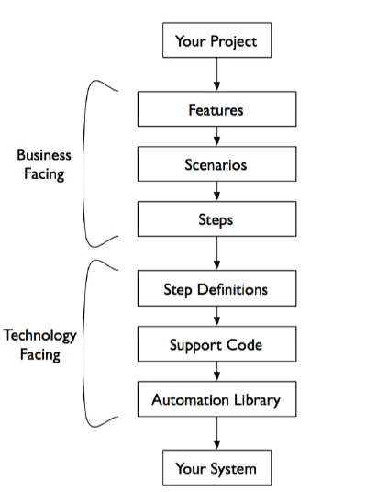
BDD - How it Works
Notes:
Gherkin’s grammar is defined in the Treetop grammar that is part of the Cucumber codebase. The grammar exists in different flavours for many spoken languages (60 at the time of writing), so that your team can use the keywords in your own language.

Slide 4
What is Gherkin?
Gherkin is a plain English text language, which helps the tool - Cucumber to interpret and execute the test scripts.
It is a Business Readable, Domain Specific Language that lets you describe software’s behavior without detailing how that behavior is implemented.
Gherkin serves two purposes — documentation and automated tests.
There are a few conventions
Single Gherkin source file contains a description of a single feature
Source files have .feature extension
Notes:
Gherkin’s grammar is defined in the Treetop grammar that is part of the Cucumber codebase. The grammar exists in different flavours for many spoken languages (60 at the time of writing), so that your team can use the keywords in your own language.

Slide 5
What is cucumber?
It is a Framework and NOT a Tool
Cucumber is a testing Framework that supports Behavior Driven Development (BDD) framework.
It defines application behavior using simple English text, defined by a language called Gherkin

Slide 6
What does cucumber do?
It reads in your specifications from plain-language text files called features, examines them for scenarios to test, and runs the scenarios against your system.
Each scenario is a list of steps for Cucumber to work through. So that Cucumber can understand these feature files, they must follow some basic syntax rules. The name for this set of rules is Gherkin

Slide 7
Why cucumber?
Communication
Collaboration
What makes Cucumber stand out from the crowd of other testing tools is that it has been designed specifically to ensure the acceptance tests can easily be read—and written—by anyone on the team. This reveals the true value of acceptance tests: as a communication and collaboration tool. The easy read- ability of Cucumber tests draws business stakeholders into the process, helping you really explore and understand their requirements
Cucumber supports over a dozen different software platforms like −Ruby on Rails, Selenium, PicoContainer, Spring Framework, Watir.

Slide 8
Edges of cucumber
Cucumber supports different languages like Java, .NET and Ruby
It acts as a bridge between the business and technical language. We can accomplish this by creating a test case in plain English text
It allows the test script to be written without knowledge of any code, it allows the involvement of non-programmers as well
It serves the purpose of end-to-end test framework unlike other tools
Due to simple test script architecture, Cucumber provides code reusability
Notes:
Does coding knowledge required?

Slide 9
Feature File Intro
Feature files are text files with .feature extension, which can be opened by any text editor as well as readable by any BDD-aware tool, such as Cucumber, JBehave or Behat.
A feature usually contains a list of scenarios. You can write whatever you want up until the first scenario, which starts with the word Scenario
Every scenario consists of a list of steps, which must start with one of the keywords Given, When, Then, But or And. Cucumber treats them all the same, but you shouldn’t.

Slide 10
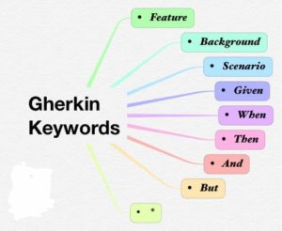
Feature file description
A simple feature file consists of the following keywords/parts −
Feature − Name of the feature under test
Description (optional) − Describe about feature under test
Scenario − What is the test scenario
Given − Prerequisite before the test steps get executed
When − Specific condition which should match in order to execute the next step.
Then − What should happen if the condition mentioned in WHEN is satisfied

Slide 11
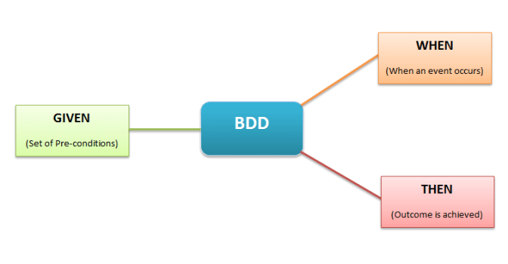
Annotations
Annotation is a predefined text, which holds a specific meaning. It lets the compiler/interpreter know, what should be done upon execution
Cucumber has got the following few annotations –
Given, When, Then, And, But, Scenario, Scenario Outline, Background, Example

Slide 12
Given When Then
Cucumber scenarios consist of steps, also known as Given, When and Then.
Cucumber doesn’t technically distinguish between these three kind of steps
However, we strongly recommend that you do! These words have been carefully selected for their purpose, and you should know what the purpose is to get into the BDD mindset

Slide 13
Given
Given steps are used to describe the initial context of the system - the scene of the scenario.
Avoid talking about user interaction in givens. If you were creating use cases, givens would be your preconditions.
When Cucumber executes a Given step, it will configure the system to be in a well-defined state, such as creating and configuring objects or adding data to a test database.
The purpose of Given steps is to put the system in a known state before the user (or external system) starts interacting with the system (in the When steps). Avoid talking about user interaction in Given’s. If you were creating use cases, Given’s would be your preconditions.
Examples:
Create records (model instances) / set up the database state.
I am logged in
Joe has a balance of £42

Slide 14
When
When steps are used to describe an event, or an action.
This can be a person interacting with the system, or it can be an event triggered by another system.
It’s strongly recommended you only have a single When step per Scenario.
If you feel compelled to add more, it’s usually a sign that you should split the scenario up into multiple scenarios.
Examples:
Interact with a web page (Webrat/Watir/Selenium interaction etc should mostly go into When steps)
Interact with some other user interface element.
Withdraw money

Slide 15
Then
The purpose of Then steps is to observe outcomes. The observations should be related to the business value/benefit in your feature description. The observations should also be on some kind of output
Examples:
Verify that something related to the Given+When is (or is not) in the output.
Check that some external system has received the expected message (was an email with specific content sent?).

Slide 16
Connectors – And & but
AND keyword is used to show conjunction between two conditions. It provides the logical AND condition between any two statements
BUT signifies logical OR condition between any two statements
AND & BUT can be used in conjunction with any other keywords like GIVEN, WHEN and THEN

Slide 17
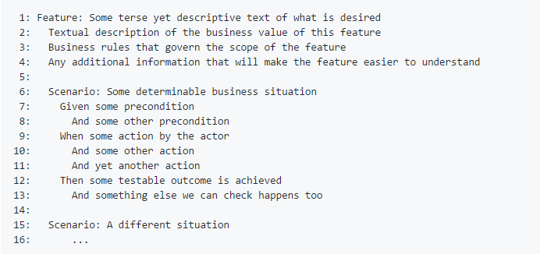
Structure of a feature file
First line starts the feature
Lines 2–4 are unparsed text, which is expected to describe the business value of this feature
Line 6 starts a scenario
Lines 7–13 are the steps for the scenario
Line 15 starts next scenario and so on

Slide 18
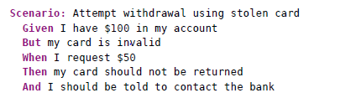
Gherkin Example

Slide 19
Background
Background allows you to add some context to the scenarios in a single feature
A Background is much like a scenario containing a number of steps.
Occasionally you’ll find yourself repeating the same Given steps in all of the scenarios in a feature.
Since it is repeated in every scenario, this is an indication that those steps are not essential to describe the scenarios; they are incidental details. You can literally move such Given steps to the background, by grouping them under a Background section.
The difference is when it is run, the background is run before each of your scenarios but after any of your Before Hooks

Slide 20
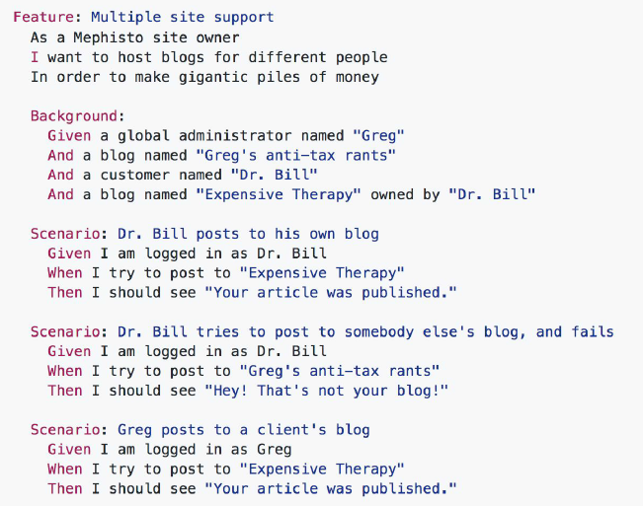
How does background looks?

Slide 21
Good practice of using Background
Don’t use “Background” to set up complicated state unless that state is actually something the client needs to know
For example, if the user and site names don’t matter to the client, you should use a high-level step such as “Given that I am logged in as a site owner”

Slide 22
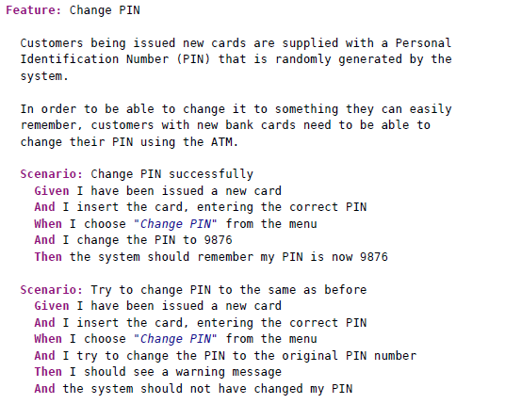
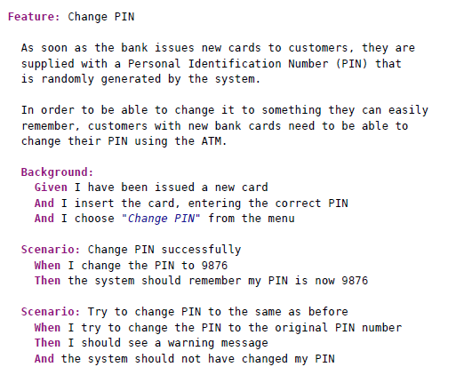
Understanding on background

Slide 23
Scenario Outline
Sometimes you have several scenarios that follow exactly the same pattern of steps, just with different input values or expected outcomes
Scenario outline helps to specify the steps once and then play multiple sets of values through them
A Scenario Outline must contain an Examples section. Its steps are interpreted as a template which is never directly run.

Slide 24
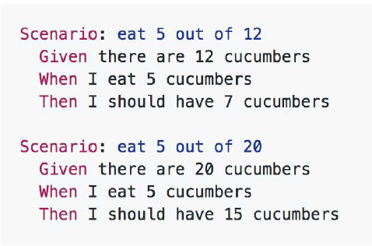
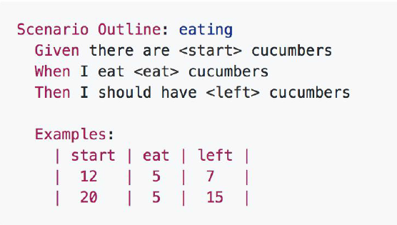
Scenario outline example

Slide 25
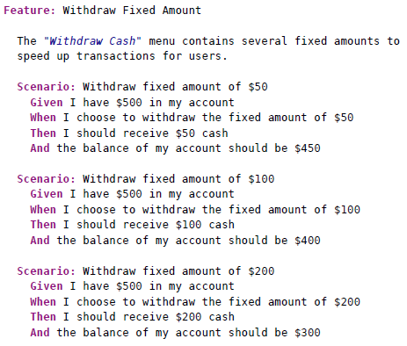
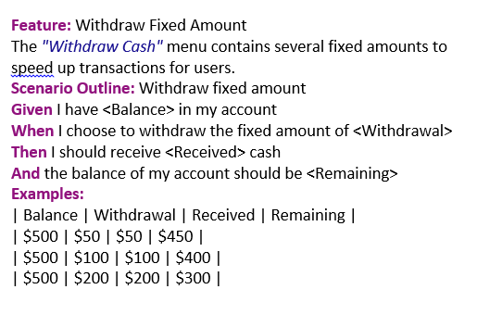
One more…
If we’re testing each of the fixed amount withdrawal buttons on the ATM

Slide 26
Step Definitions
A Step Definition is a Java method with an expression that links it to one or more Gherkin steps.
When Cucumber executes a Gherkin step in a scenario, it will look for a matching step definition to execute.
Step definitions are defined in files under features/step_definitions/*_steps.java
Here is a simple example:
Scenario: Login functionality exists.
Given I have open the browser
Step Definition:
@Given("^I have open the browser$")
public void openBrowser()
{
System.setProperty("webdriver.chrome.driver", “C:/Selenium/chromedriver_win32/chromedriver.exe");
driver = new ChromeDriver(); }

Slide 27
Steps
Successful steps : When Cucumber finds a matching step definition it will execute it. If the block in the step definition doesn’t raise an error, the step is marked as successful (green).
Failed steps: When a step definition’s method or function is executed and raises an error, the step is marked as failed (red).
Undefined steps: When Cucumber can’t find a matching step definition, the step gets marked as undefined (yellow), and all subsequent steps in the scenario are skipped.
Pending steps: When a step definition’s method or function invokes the pending method, the step is marked as pending.
Skipped steps : Steps that follow undefined, pending, or failed steps are never executed, even if there is a matching step definition.

Slide 28
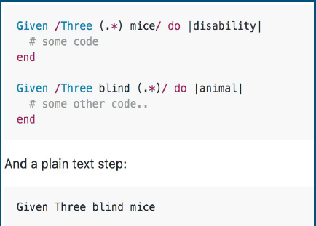
Ambiguous Steps
Cucumber can’t make a decision about what Step Definition to execute, and will raise a Cucumber::Ambiguous error

Slide 29
Comment
Comment is basically a piece of code meant for documentation purpose and not for execution. Be it a step definition file or a feature file, to make it more readable and understandable
Feature File − In case of feature file, we just need to put # before beginning your comment
Step definition file − If you are using Java as a platform then mark your comments with “//”

Slide 30
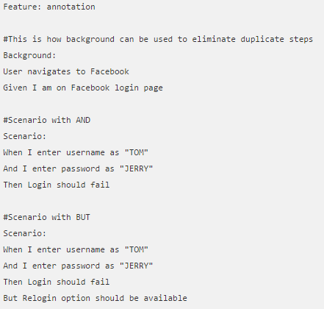
Comment Example

Slide 31
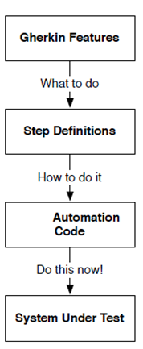
Step definitions are translators

Slide 32
Hooks
Cucumber hook allows us to better manage the code workflow and helps us to reduce the code redundancy. We can say that it is an unseen step, which allows us to perform our scenarios or tests
More often we use two types of hooks: “Before” hook and “After” hook
Method/function/piece of code, defined within Before and After hooks, always run, even if the scenario gets passed or failed
As the name suggests, before hook gets executed well before any other test scenarios, and after hook gets executed after executing all the scenarios
Hooks are defined within the step definition file only

Slide 33
Cucumber tags
Now there can be certain situation in the project where you like to execute just a SmokeTests or End2EndTests or may be RegressionTests. Based on your situation, you can tag your scripts by using @.
Tag starts with “@”. After “@” you can have any relevant text to define your tag like @SmokeTests just above the scenarios you like to mark.
Then to target these tagged scenarios just specify the tags names in the CucumberOptions as tags = {“@SmokeTests”}.

Slide 34
Sample Program
// Feature File
Feature: Test Order Hooks
Scenario: First scenario to test Order Hooks functionality
Given this is the first step
When this is the second step
Then this is the third step
Scenario: Second scenario to test Order Hooks functionality
Given this is the first step
When this is the second step
Then this is the third step

Slide 35
Sample Program
// Step Definitions
package stepDefinition;
import cucumber.api.java.en.Given;
import cucumber.api.java.en.Then;
import cucumber.api.java.en.When;
public class Hooks_Steps {
@Given("^this is the first step$")
public void This_Is_The_First_Step(){
System.out.println("This is the first step");
}
@When("^this is the second step$")
public void This_Is_The_Second_Step(){
System.out.println("This is the second step");
}
@Then("^this is the third step$")
public void This_Is_The_Third_Step(){
System.out.println("This is the third step");
}}

Slide 36
Sample Program
// Hooks
package utilities;
import cucumber.api.java.After;
import cucumber.api.java.Before;
public class Hooks {
@Before
public void beforeScenario(){
System.out.println("This will run before the every Scenario"); }
@Before
public void beforeScenarioStart(){
System.out.println("-----------------Start of Scenario-----------------"); }
@After
public void afterScenarioFinish(){
System.out.println("-----------------End of Scenario-----------------"); }
@After
public void afterScenario(){
System.out.println("This will run after the every Scenario"); }
}

Slide 37
Sample Program
// Output
Feature: Test Order Hooks
-----------------Start of Scenario-----------------
This will run before the every Scenario
This is the first step
This is the second step
This is the third step
-----------------End of Scenario-----------------
This will run after the every Scenario
-----------------Start of Scenario-----------------
This will run before the every Scenario
This is the first step
This is the second step
This is the third step
-----------------End of Scenario-----------------
This will run after the every Scenario

Slide 38
Test Runner Class
In very simple terms, Cucumber test runner class is one of the many mechanisms using which you can run Cucumber feature file. The test runner class that will use in this article is a JUnit runner class.
In addition to running a cucumber feature file, the test runner class also acts as an interlink between feature files and step definition classes
Sample code:
package testRunners;
import org.junit.runner.RunWith;
import cucumber.api.CucumberOptions;
import cucumber.api.junit.Cucumber;
@RunWith(Cucumber.class)
@CucumberOptions(features="resources/features", glue="")
public class TestRunner_GoogleHomepage {}

Slide 39
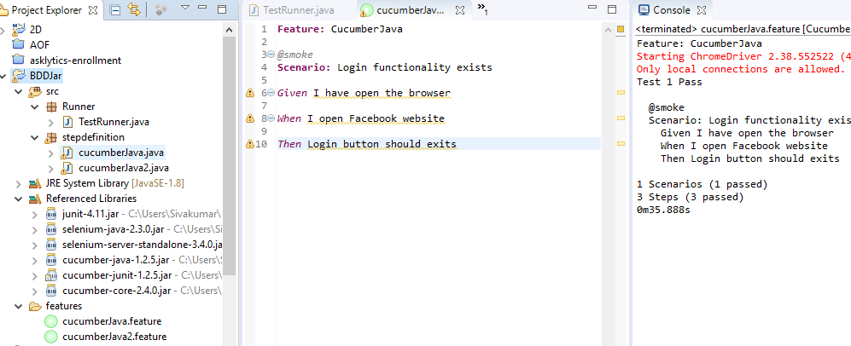
Project Structure

Slide 40
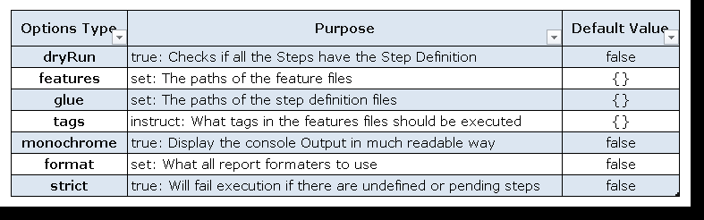
Cucumber option in Test Runner class
Run cucumber features
First: Run the feature from eclipse. by right clicking the feature file –> Run as –> Cucumber feature.
Second: we can run this framework from command line as well. Open command prompt. CD till project root directory. And Run following command:
mvn clean test

Slide 41
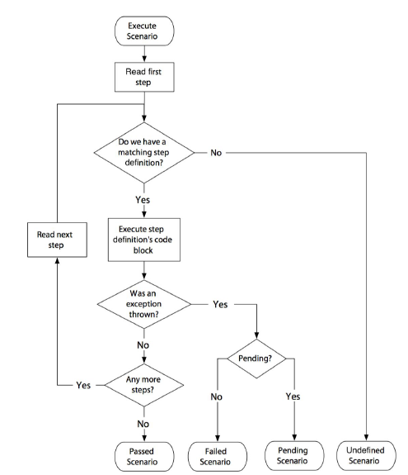
How cucumber executes?

Slide 42
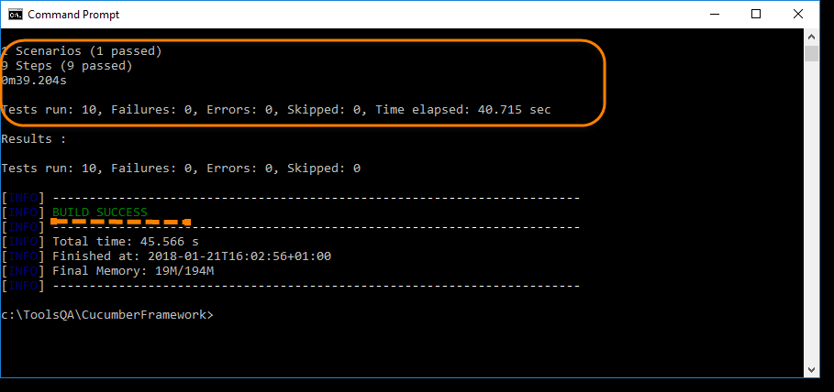
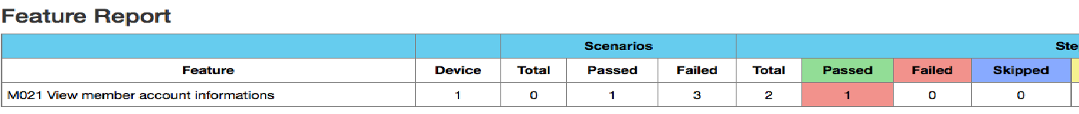
Cucumber Execution
Get the Report from target/cucumber-reports/ for Maven project.

Slide 43

Assignment
Create Feature file for http://newtours.demoaut.com/mercuryregister.php?osCsid=40e995b7ee7e1262b1aa02840b8076fa registration.
Perform Data Iteration with any sign-in and sign-out any login functionality.

Slide 44


Slide 45


Slide 46


Slide 47


